Slide 1
Machine Learning- 1
Introduction to Machine Learning and ID3

Slide 2
Introduction-Machine Learning
Machine learning is a branch of artificial intelligence, concerns the construction and study of systems that can learn from data.
Machine learning and Data mining
Machine learning →prediction
Known properties learned from the training data.
Data mining →discovery
Previously unknown properties in the data.
With overlapping

Slide 3
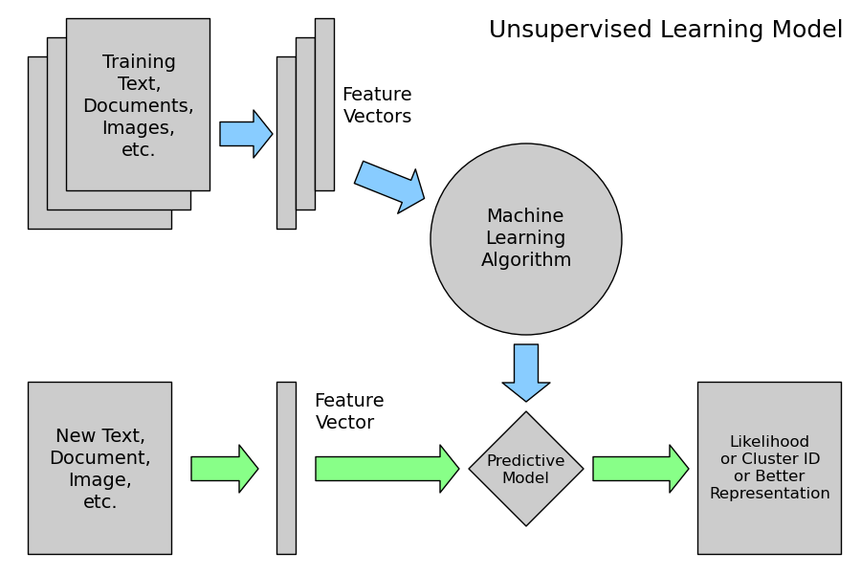
Supervised Learning Model

Slide 4
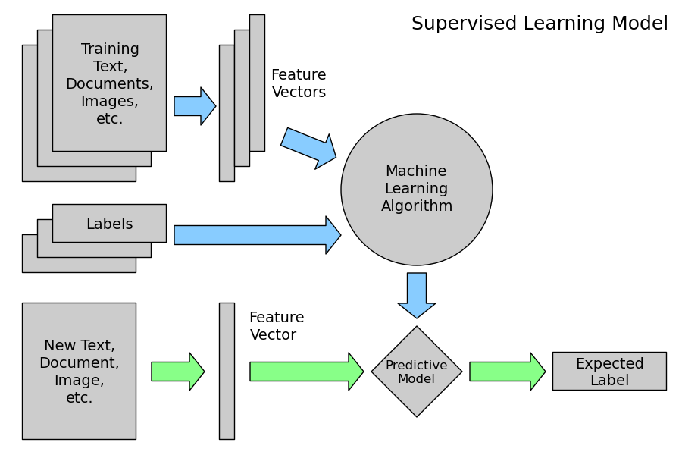
Supervised Learning Model

Slide 5
What is Inductive Learning?
Inductive Learning
Knowledge/Generalization (Rules/Decision Tree)
Data Set (Specific Examples or Activities) + known Classifications
A form of supervised learning.
Given a set of examples (inputs and their classifications via some function), the system tries to approximate the classification rules.

Slide 6
What is Deductive Reasoning?
Deductive Reasoning
New Data Set (Specific Examples or Activities) + Knowledge/Generalization (Rules)
Classifications

Slide 7
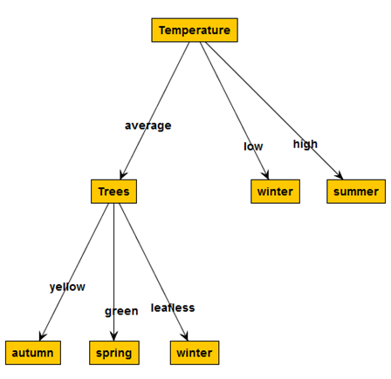
What is Decision Tree?
Root Node: Attribute
Edges: Attribute Value
A decision tree is a tree in which each branch node represents a choice between a number of alternatives, and each leaf node represents a decision.
Leaf Node: output, class or decision

Slide 8

ID3 Introduction
ID3 →C 4.5 →C 5.0
ID3 (Iterative Dichotomiser 3) is an algorithm invented by Ross Quinlan used to generate a decision tree from a dataset using Shannon Entropy.
Typically used in the machine learning and natural language processing domains.

Slide 9
ID3 basics
ID3 employs Top_Down Induction of Decision Tree (greedy algorithm)
Attribute selection is the fundamental step to construct a decision tree.
Attribute will be selected to become a node of the decision tree and so on.

Slide 10
ID3 basics
We are given a set of records.
Each record has the same structure, consisting of a number of attribute/value pairs.
One of these attributes represents the category of the record.
The problem is to determine a decision tree that on the basis of answers to questions about the non-category attributes predicts correctly the value of the category attribute.
Usually the category attribute takes only the values {true, false}, or {success, failure}, or something equivalent. In any case, one of its values will mean failure.

Slide 11
Example of Playing Golf
The categorical attribute specifies whether Play or not to Play.
The non-categorical attributes are:
ATTRIBUTE | POSSIBLE VALUES
outlook | sunny, overcast, rain
temperature | continuous
humidity | continuous
windy | true, false

Slide 12
Example of Playing Golf
continuous
The training data is:
OUTLOOK | TEMPERATURE | HUMIDITY | WINDY | PLAY
sunny | 85 | 85 | false | Don't Play
sunny | 80 | 90 | true | Don't Play
overcast | 83 | 78 | false | Play
rain | 70 | 96 | false | Play
rain | 68 | 80 | false | Play
rain | 65 | 70 | true | Don't Play
overcast | 64 | 65 | true | Play
sunny | 72 | 95 | false | Don't Play
sunny | 69 | 70 | false | Play
rain | 75 | 80 | false | Play
sunny | 75 | 70 | true | Play
overcast | 72 | 90 | true | Play
overcast | 81 | 75 | false | Play
rain | 71 | 80 | true | Don't Play

Slide 13
There are two continuous ranges, Temperature and Humidity. ID3 does not directly deal with such cases.
OUTLOOK | TEMPERATURE | HUMIDITY | WINDY | PLAY
sunny | Hot | High | false | Don't Play
sunny | Hot | High | true | Don't Play
overcast | Hot | High | false | Play
rain | Mild | High | false | Play
rain | Cool | Normal | false | Play
rain | Cool | Normal | true | Don't Play
overcast | Cool | Normal | true | Play
sunny | Mild | High | false | Don't Play
sunny | Cool | Normal | false | Play
rain | Mild | Normal | false | Play
sunny | Mild | Normal | true | Play
overcast | Mild | High | true | Play
overcast | Hot | Normal | false | Play
rain | Mild | High | true | Don't Play
Categorical attribute
Non-Categorical attribute

Slide 14
Entropy
The idea of entropy comes from a principle of thermodynamics dealing with energy.
It represent the amount of energy in a system that is no longer available for doing mechanical work
Everything in the universe eventually moves from order to disorder, and entropy is the measurement of that change.
The word was used to describe the measurement of disorder by the German physicist Rudolph Clausius and appeared in English in 1868.
The resulting change from formed to free, from ordered to disordered increases the entropy.
Notes:
http://crackingthenutshell.com/what-is-information-part-2a-information-theory/

Slide 15
ID3 basics
There are two terms Entropy and Information Gain is used to process attribute selection
Entropy is used to measure how informative (uncertaintity) is a node.
Shannon showed that the entropy is equivalent to the potential information gain once the experimenter learns the outcome of the experiment, and is given by the following formula:

Slide 16
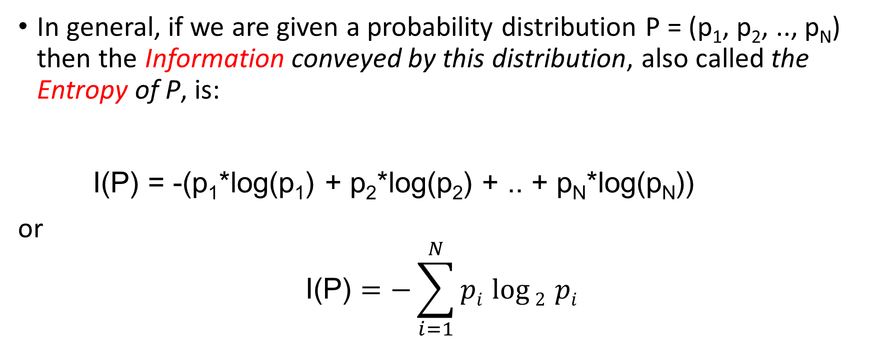
ID3 basics
In general, if we are given a probability distribution P = (p₁, p₂, .., p_{N}) then the Information conveyed by this distribution, also called the Entropy of P, is:
I(P) = -(p₁*log(p₁) + p₂*log(p₂) + .. + p_{N}*log(p_{N}))
or
$$\text{I}\text{(}\text{P}\text{)}=−\sum_{i=1}^{N}{pi \log{2 }}pi$$
Notes:
http://www.tim-thompson.com/entropy1.html
ntropy and Statistical Mechanics
In the later 1800's, Maxwell, Ludwig Boltzmann and Josiah Willard Gibbs extended the ideas of classical thermodynamics, through the new "molecular theory" of gases, into the domain we now call statistical mechanics. In classical thermodynamics, we deal with single extensive systems, whereas in statistical mechanics we recognize the role of the tiny constituents of the system. The temperature, for instance, of a system defines a macrostate, whereas the kinetic energy of each molecule in the system defines a microstate. The macrostate variable, temperature, is recognized as an expression of the average of the microstate variables, an average kinetic energy for the system. Hence, if the molecules of a gas move faster, they have more kinetic energy, and the temperature naturally goes up.
Equation 6 below is the general form of the definition of entropy in statistical mechanics, as first derived by Boltzmann. You can see Boltzmann's own derivation in his Lectures on Gas Theory(available as a Dover reprint), but more modern treatments might be easier to follow, such as Statistical Physics by Gregory H. Wannier, or The Principles of Statistical Mechanics by Richard C. Tolman (both also available as Dover reprints).
S = -k·[P_{i}log(P_{i})] Equation 6

Slide 17
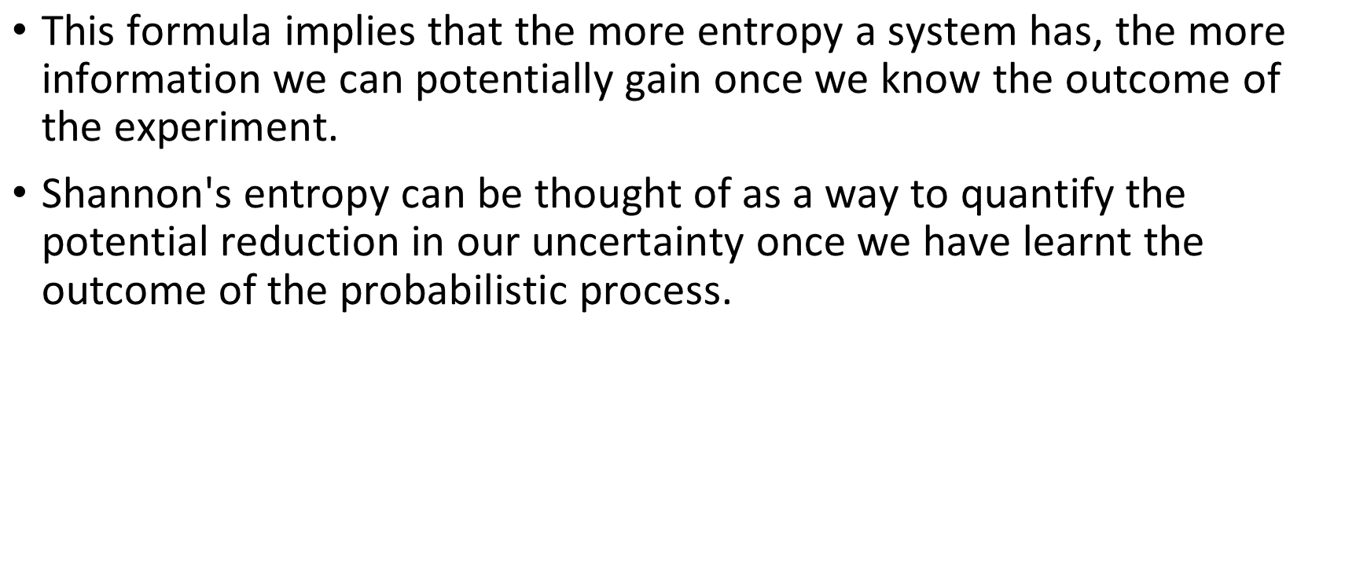
ID3 basics
$\text{This} \text{formula} \text{implies} \text{that} \text{the} \text{more} \text{entropy} \text{a} \text{system} \text{has}\text{, }\text{the} \text{more} \text{information} \text{we} \text{can} \text{potentially} \text{gain} \text{once} \text{we} \text{know} \text{the} \text{outcome} \text{of} \text{the} \text{experiment}\text{. }$
$\text{Shannon}\text{′}\text{s} \text{entropy} \text{can} \text{be} \text{thought} \text{of} \text{as} \text{a} \text{way} \text{to} \text{quantify} \text{the} \text{potential} \text{reduction} \text{in} \text{our} \text{uncertainty} \text{once} \text{we} \text{have} \text{learnt} \text{the} \text{outcome} \text{of} \text{the} \text{probabilistic} \text{process}\text{.}$

Slide 18
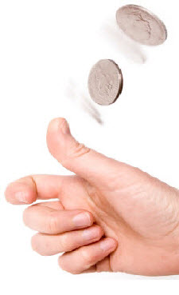
ID3 basics
Entropy(S)= - P(positive)log₂P(positive) -P(negative)log₂P(negative)
For example,
if P is (0.5, 0.5) then I(P) is 1,
if P is (0.67, 0.33) then I(P) is 0.92,
if P is (1, 0) then I(P) is 0.
[Note that the more uniform is the probability distribution, the greater is its information.]
set S
Positive
Negative

Slide 19
ID3 basics
Suppose a set T of records (training records) is partitioned into disjoint exhaustive classes C1, C2, .., Ck (categories) on the basis of the value of the categorical attribute, then the information needed to identify the class of an element of T is
Info(T) = I(P),
where P is the probability distribution of the partition (C1, C2, .., Ck):
Step1 : In our golfing example, we have
Info(T) = I(9/14, 5/14) = -(9/14)log2(9/14)-(5/14)log2(5/14)= 0.94

Slide 20
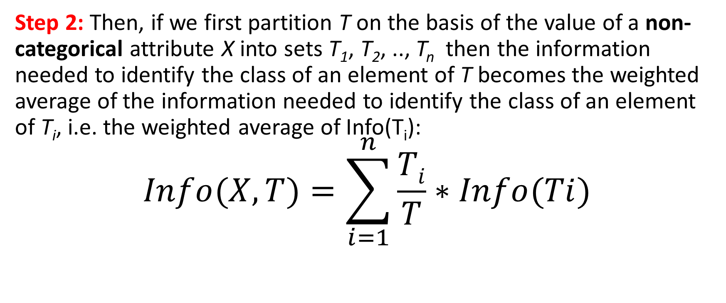
ID3 basics
Step 2: Then, if we first partition T on the basis of the value of a non-categorical attribute X into sets T₁, T₂, .., T_{n} then the information needed to identify the class of an element of T becomes the weighted average of the information needed to identify the class of an element of T_{i}, i.e. the weighted average of Info(T_{i}):
$$Info(X,T)=\sum_{i=1}^{n}{\frac{Ti}{T}}∗Info(Ti)$$

Slide 21
OUTLOOK | TEMPERATURE | HUMIDITY | WINDY | PLAY
sunny | Hot | High | false | Don't Play
sunny | Hot | High | true | Don't Play
overcast | Hot | High | false | Play
rain | Mild | High | false | Play
rain | Cool | Normal | false | Play
rain | Cool | Normal | true | Don't Play
overcast | Cool | Normal | true | Play
sunny | Mild | High | false | Don't Play
sunny | Cool | Normal | false | Play
rain | Mild | Normal | false | Play
sunny | Mild | Normal | true | Play
overcast | Mild | High | true | Play
overcast | Hot | Normal | false | Play
rain | Mild | High | true | Don't Play

Slide 22
ID3 basics
In the case of our golfing example, for the attribute Outlook we have:
Info(Outlook,T) = 5/14*I(2/5,3/5) + 4/14*I(4/4,0) + 5/14*I(3/5,2/5)
= 0.694
Info(Windy,T) = (8/14)Entropy(S_{false})+(6/14)Entropy(S_{true})
= (8/14)I(6/8,2/8) +(6/14) I(3/6, 3/6)
= (8/14)*(-6/8Log2(6/8)-2/8Log2(2/8)) +
(6/14)*(-3/6Log2(3/6)-3/6Log2(3/6))
= 0.811 + 1
Windy: Weak=8→(6+,2-), Strong=6→(3+,3-)

Slide 23
ID3 basics
Step 3: Consider the quantity Gain(X,T) defined as
Gain(X,T) = Info(T) - Info(X,T)
This represents the difference between the information needed to identify an element of T and the information needed to identify an element of T after the value of attribute X has been obtained, that is, this is the gain in information due to attribute X
In our golfing example, for the Outlook attribute the gain is:
Gain(Outlook,T) = Info(T) - Info(Outlook,T) = 0.94 - 0.694 = 0.246
Gain(Windy,T) = Info(T) - Info(Windy,T) = 0.94 - (8/14)(0.811)-(6/14)(1)
= 0.048

Slide 24
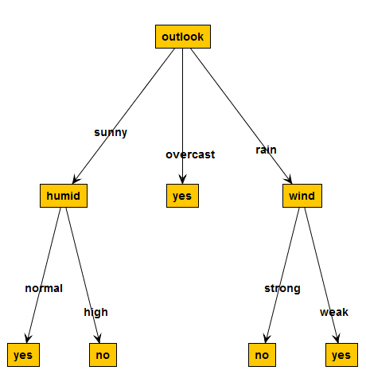
ID3 basics
Step 4: Select attribute with the maximum information gain for splitting:
Gain(Windy S, T)=0.048
Gain(Humidity, T) =0.151
Gain(Temperature, T)=0.029
Gain(Outlook, T) = 0.246

Slide 25
ID3 basics
Step 5: Apply ID3 to each child node of this root, until leaf node or node that has entropy=0 are reached.
Use this notion of gain to rank attributes and to build decision trees where at each node is located the attribute with greatest gain among the attributes not yet considered in the path from the root.

Slide 26
The intent of this ordering are twofold:
To create small decision trees so that records can be identified after only a few questions.
To match a hoped for minimality of the process represented by the records being considered.

Slide 27
The ID3 Algorithm
The ID3 algorithm is used to build a decision tree, given a set of non-categorical attributes C1, C2, .., Cn, the categorical attribute C, and a training set T of records.
function ID3 (R: a set of non-categorical attributes,
C: the categorical attribute,
S: a training set) returns a decision tree;
begin
If S is empty, return a single node with value Failure;
If S consists of records all with the same value for
the categorical attribute,
return a single node with that value;
If R is empty, then return a single node with as value

Slide 28
the most frequent of the values of the categorical attribute
that are found in records of S; [note that then there
will be errors, that is, records that will be improperly
classified];
Let D be the attribute with largest Gain(D,S)
among attributes in R;
Let {dj| j=1,2, .., m} be the values of attribute D;
Let {Sj| j=1,2, .., m} be the subsets of S consisting
respectively of records with value dj for attribute D;
Return a tree with root labeled D and arcs labeled
d1, d2, .., dm going respectively to the trees
ID3(R-{D}, C, S1), ID3(R-{D}, C, S2), .., ID3(R-{D}, C, Sm);
end ID3;

Slide 29
Using Gain Ratios
The notion of Gain tends to favor attributes that have a large number of values.
For example, if we have an attribute D that has a distinct value for each record, then Info(D,T) is 0, thus Gain(D,T) is maximal.

Slide 30
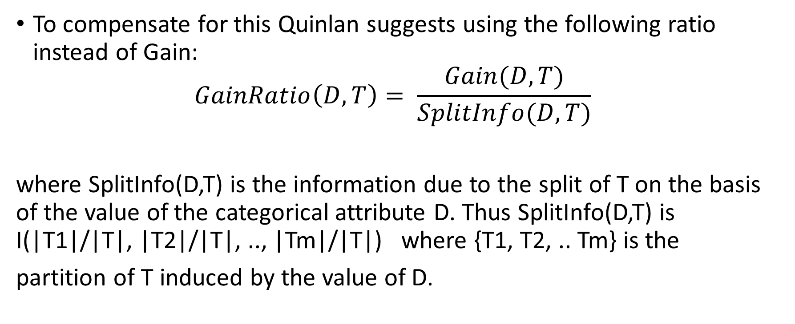
Using Gain Ratios
To compensate for this Quinlan suggests using the following ratio instead of Gain:
$$GainRatio\left(D,T\right)= \frac{Gain(D,T)}{SplitInfo(D,T)}$$
where SplitInfo(D,T) is the information due to the split of T on the basis of the value of the categorical attribute D. Thus SplitInfo(D,T) is I(|T1|/|T|, |T2|/|T|, .., |Tm|/|T|) where {T1, T2, .. Tm} is the partition of T induced by the value of D.

Slide 31
In the case of our golfing example SplitInfo(Outlook,T) is
-5/14*log(5/14) - 4/14*log(4/14) - 5/14*log(5/14) = 1.577
thus the GainRatio of Outlook is 0.246/1.577 = 0.156. And SplitInfo(Windy,T) is
-6/14*log(6/14) - 8/14*log(8/14) = 6/14*0.1.222 + 8/14*0.807 = 0.985
thus the GainRatio of Windy is 0.048/0.985 = 0.049

Slide 32
C4.5 Extensions
Handling both continuous and discrete attributes.
Handling training data with missing attribute values
Pruning trees after creation.

Slide 33
Continuous-valued attributes
Say that attribute Ci has a continuous range.
We examine the values for this attribute in the training set in increasing order, A1, A2, .., Am. Then for each value Aj, j=1,2,..m, we partition the records into those that have Ci values up to and including Aj, and those that have values greater than Aj.
For each of these partitions we compute the gain, or gain ratio, and choose the partition that maximizes the gain.
In our Golfing example, for humidity, if T is the training set, we determine the information for each partition and find the best partition at 75. Then the range for this attribute becomes {<=75, >75}.
Notice that this method involves a substantial number of computations.

Slide 34
Continuous-valued attributes
sort the numeric attribute values,
Identify adjacent examples that differ in their target classification to pick the threshold.
Humidity | Play ball
0.9 | No
0.87 | No
0.93 | Yes
0.89 | Yes
0.80 | Yes
0.59 | No
0.77 | Yes
0.91 | No
0.68 | Yes
0.84 | Yes
0.72 | Yes
0.49 | Yes
0.74 | Yes
0.86 | No
Humidity | 0.68 | 0.72 | 0.87 | 0.9 | 0.91
Humidity | yes | yes | no | no | no
Humidity>(0.72+0.87)/2 Humidity>0.795

